Slide 1
Utah State Council 2019-2020 Organizational Meeting Saint Francis of Assisi Parish Council 1136 Orem, Utah 29 June 2019

Slide 2
Utah State Council Organization Meeting Breakfast (here in the gym) 8:00 AM – 8:59 AM

Slide 3
Utah State Council Organization Meeting Rosary (here in the gym) 9:00 AM – 9:25 AM

Slide 4
Utah State Council Organization Meeting Saint Francis of Assisi Orem, UT 29-JULY-2019 9:30 AM Come to Order

Slide 5
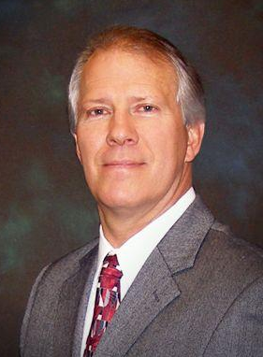
Meeting Comes to Order
Greg Keller Knights of Columbus Utah State Deputy

Slide 6
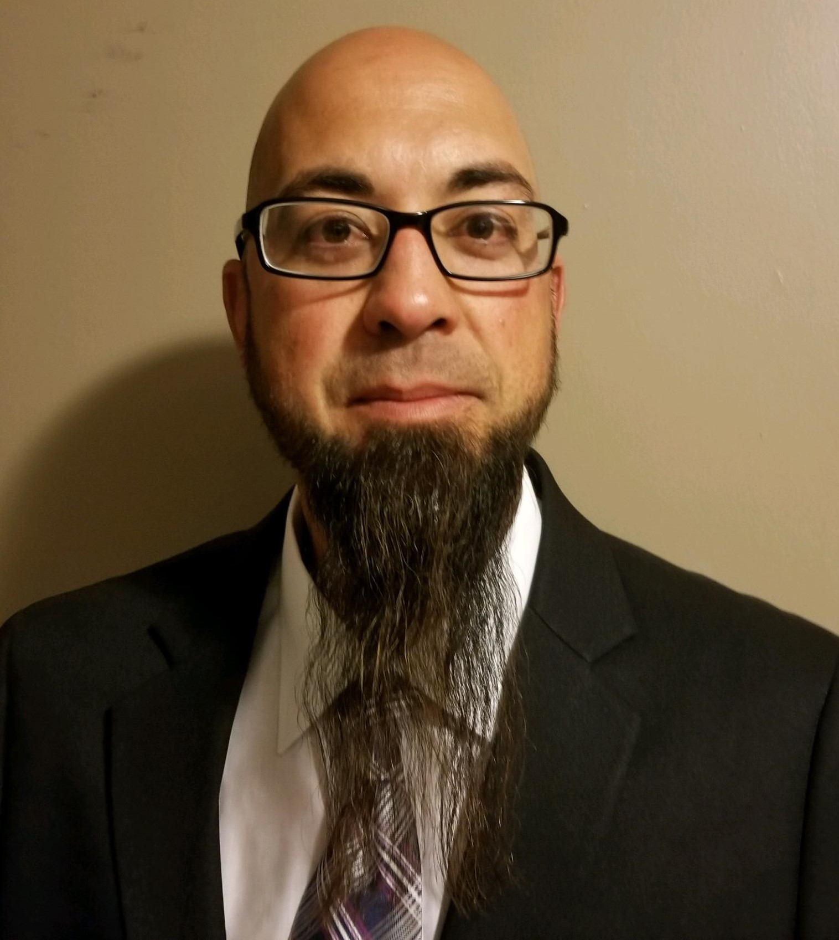
Warden’s Report on Membership Cards
Ryan Graveley Knights of Columbus Utah State Warden

Slide 7
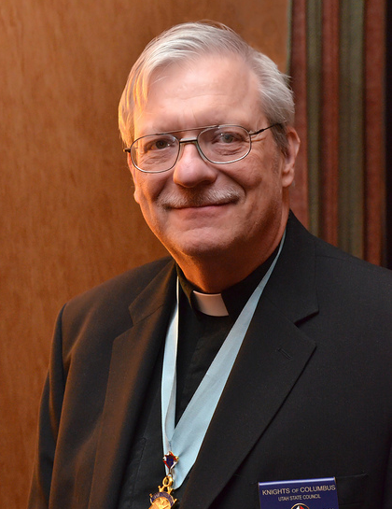
Opening Prayer
Rev. James Blaine Knights of Columbus Utah State Chaplain Emeritus

Slide 8
Pledge of Allegiance
Ryan Graveley Knights of Columbus Utah State Warden

Slide 9
Pledge of Allegiance
I pledge allegiance to the flag of the United States of America, and to the Republic for which it stands, one Nation under God, indivisible, with liberty and justice for all.

Slide 10
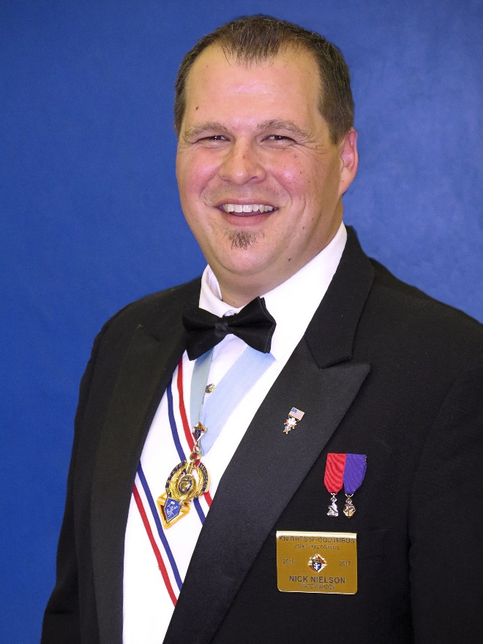
Mileage Coupons Don’t seal the envelope!
Nick Nielson Knights of Columbus Utah State Secretary

Slide 11
Opening Remarks
Greg Keller Knights of Columbus Utah State Deputy

Slide 12
Chaplain Remarks
Rev. James Blaine Knights of Columbus Utah State Chaplain Emeritus

Slide 13
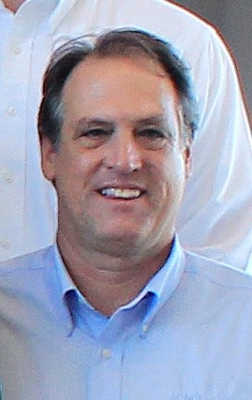
Supreme Representative
Ken White
Knights of Columbus
Regional Training Director

Slide 14
Break
Scheduled Break
10:30 AM to 10:45 AM
Actual Break
Now until…
Have lunch reservations today?
State Warden Ryan has the meal tickets.

Slide 15
Working with your Parish Priest
Rev. James Blaine Knights of Columbus Utah State Chaplain Emeritus

Slide 16
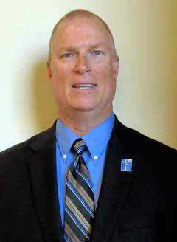
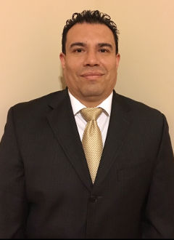
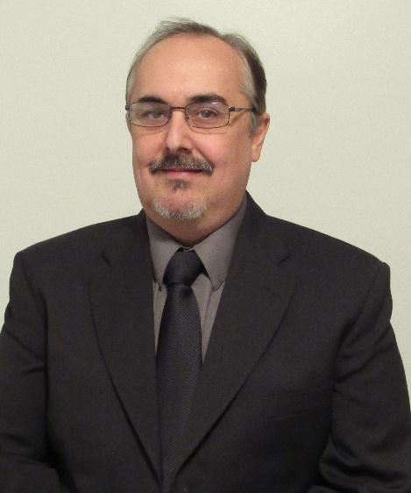
Fraternal Benefits
Gene Carlos Tom
Trombetti Lira Pinelle
https://utahknights.org/insurance/
Notes:
Thank you
Today, we’re going to discuss:
Knights of Columbus and Faithful Catholic Citizenship
Prohibited and Permitted Political Activity
Guidelines for Knights of Columbus Nonpartisan National Voter Registration Program
Let’s begin with an overview of Knights of Columbus and Faithful Catholic Citizenship

Slide 17
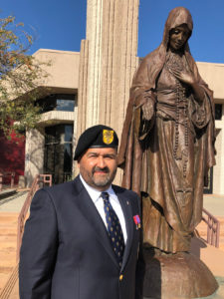
Patriotic (4th) Degree Report
Francisco Carmona Knights of Columbus District Master - Utah

Slide 18
Fourth-Degree Report
Francisco Carmona Knights of Columbus District Master - Utah

Slide 19
Thank you!!!
To all the outgoing
Faithful Navigators
Welcome!
To all the incoming
Faithful Navigators

Slide 20
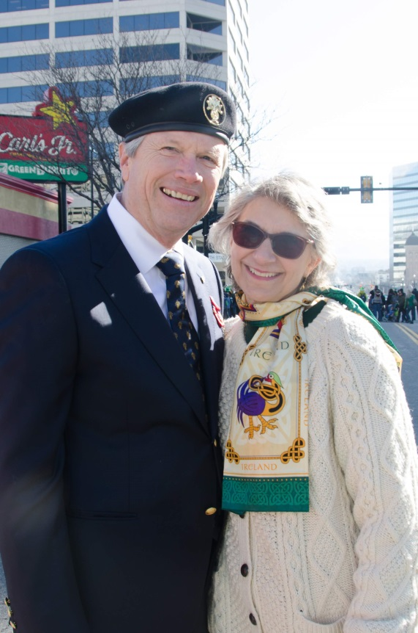
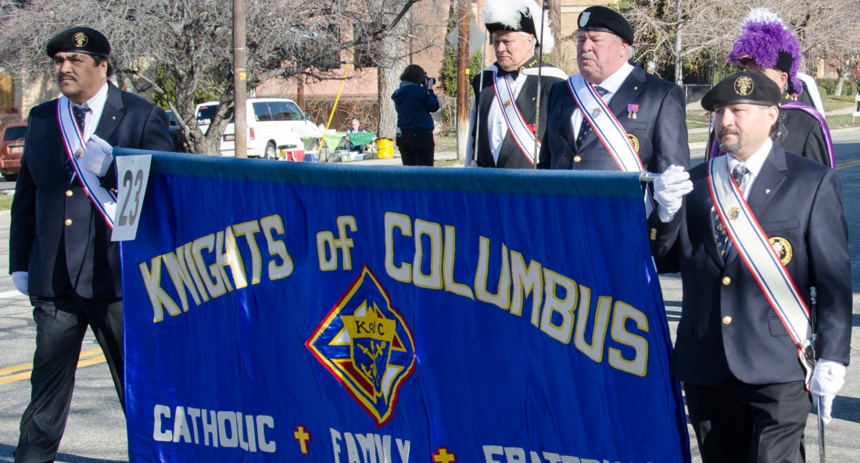
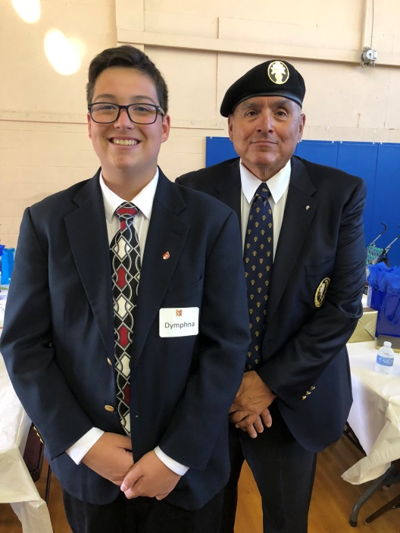
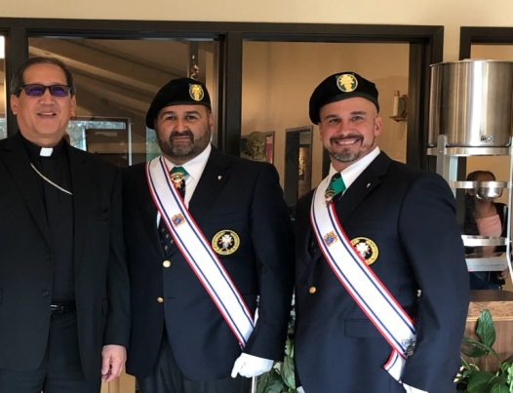
New Era Begins July 1st, 2019

Slide 21
Utah District Marshals
Todd Holzhauser Chief Marshal
801-541-1589 or tbholz@mac.com
Dan Castelli Marshal Northern Counties
801-735-4683 or trjndan127@gmail.com
Stacey Yeager Marshal of Salt Lake, Tooele, & Wasatch Counties
385-245-5103 or utahmarshalwest@gmail.com
Richard Vigor Marshal Utah and Carbon County
801-230-9656 or ricahrdvigor@hotmail.com
William Lund Marshal or Southern Counties
435-590-1338 or totoweap@q.com

Slide 22
Exemplifications 2019-2020
Sunday October 13, 2019 (Fall)
Assembly #3501 Saint John Paul II
(Cedar City)
January or February 2020 (Winter)
Assembly #1144 Father Francisco Atanasio Dominguez (Salt Lake City)
April or June (Spring)
Assembly #1429 Rt. Rev. Msgr. Patrick M. Cushnahan (Ogden)

Slide 23
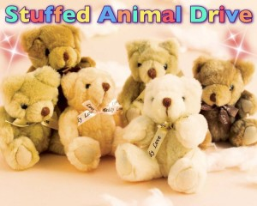
4 District Projects
www.apscnp.org
Faithful Navigators

Slide 24
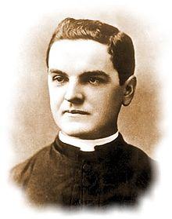
March 29th, 2020
Founders Day Dinner
Hosted by:
Assemblies 1144 and 2577
Location & Times
OBD

Slide 26
“Faith in Action” Program Model
Ryan Graveley Knights of Columbus Utah State Warden State Program Director

Slide 27
Faith in Action
New Program Categories
Faith - Spiritual Reflection, Holy Hour, Sacramental Gifts.
Family - Family Prayer Night, Good Friday Family Promotion.
Community - Helping Hands.
Life - Mass for People with Special Needs, Pregnancy Center Support, Novena for Life.

Slide 28
Faith in Action
Required Programs
Faith - Spiritual Reflection
Family - Consecration to the Holy Family
Community - Helping Hands
Live - Novena for Life

Slide 29
Faith in Action
Columbian Award
Conduct at least four major programs in each of the Faith in Action Categories.
Complete the Columbian Award Application (SP7) by June 30
Submit the Service Program Personnel Report (365) by August 1

Slide 30
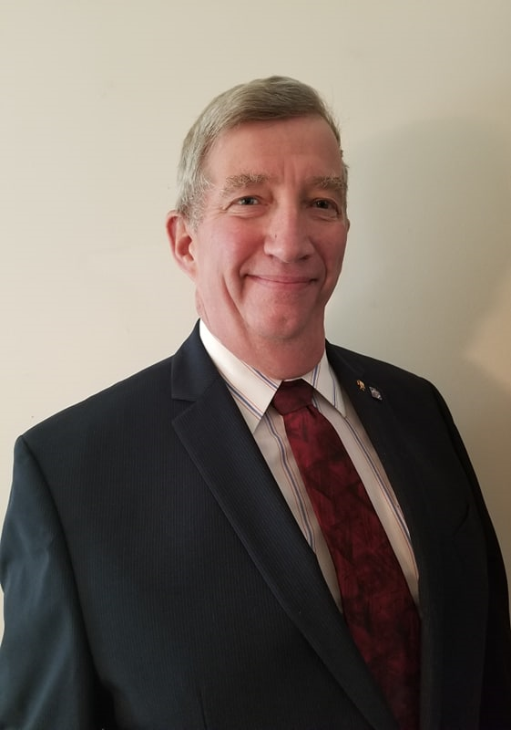
KofC Utah State Insurance Policy
William “Bill” Kelly Knights of Columbus Utah State Advocate

Slide 31
Lunch Break
Scheduled Lunch Break
11:45 AM – 12:30 PM
Those who made reservations will receive food first.
Those without reservations will go last, as food permits.
Lunch is ready!

Slide 32
Safe Environment
William “Bill” Kelly Knights of Columbus Utah State Advocate

Slide 33
Requirements
Based on position
Reporting
Training (Knights & Diocese)
Background Check

Slide 34
Reporting
All Knights are required to report any youth-related activity that looks suspicious to authorities to investigate.

Slide 35
Training/Knights
Knights training can be completed online using Paesidium or via workbook self-study guides
https://armatus2.praesidiuminc.com/armatusUser/login
Three modules
Meet Sam
Policies- K of C
Duty to report
Good for 3 years

Slide 36
Training/Diocese
Salt Lake City Diocese website
https://www.dioslc.org/offices/office-of-safe-environment
Click on “Adult Certification: Child & Youth Protection Training”
https://saltlakecity.cmgconnect.org/
Good for 3 years

Slide 37
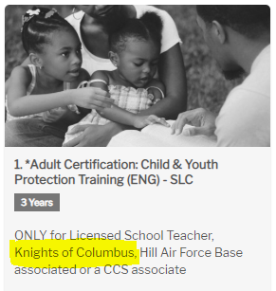
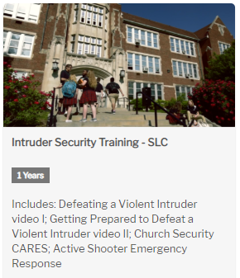
Training/Diocese
Adult Certification: Child & Youth Protection Training (ENG) - SLC
Intruder Security Training - SLC

Slide 38
Positions Requiring Training
State Deputy
State Advocate
State Youth Director
Faithful Navigators *
Grand Knights (every council)
Program Directors (every council)
Community Directors (every council)
Family Directors (every council)
* Doesn’t apply in Utah. Is only required if the Assembly sponsors a Columbian Squires Circle. We have no Squires Circles in Utah.

Slide 39
Positions Requiring Training
Every Knight involved with youth
Free Throw Championship
Soccer Challenge
Essay Contest
Scouting
School activities
Any activity involving youth

Slide 40
Positions Requiring Background Checks
State Squires Chairman *
State Youth Director
Family Directors (every council)
Community Directors (every council)
The Diocese will accept a background check completed by the Knights but not Knights Training. Must complete both the Diocese Training and the Knights Training.
* Not applicable in Utah.

Slide 41
Certificates
I have access to the records for Knights training but not the Diocese. Please send me a copy of your diocese certificate.

Slide 42
Retention, Suspension, and Withdrawal Procedures
William “Bill” Kelly Knights of Columbus Utah State Advocate Retention Chairman

Slide 43
Prepare for the Year Ahead
Greg Keller Knights of Columbus Utah State Deputy

Slide 44
Prepare for the Year Ahead
Councils should have strong relationships with pastors and leverage pastors/chaplains in recruiting efforts.
17 Pastors moving to new Parishes by August 1st.
Working with your Pastor.
Father is the key to everything. Engage with him.
Put yourself in his shoes. Know what he’s thinking.
Actions speak louder than words.
Talk to him about Faith in Action.
Be in service to him and the parish.

Slide 45
Prepare for the Year Ahead
Archbishop Lori
We’re at the cross roads – the pressure is on us.
Church needs Catholic men filled with Faith and Hope.
Ephesians 6 – Putting on the Armor of God.
6 Pieces of Armor for Spiritual War: the belt of truth, the breastplate of righteousness, the shoes of the gospel of peace, the shield of faith, the helmet of salvation, and the sword of the Spirit
Padre Pio – Pray, Hope, Don’t Worry
If you keep doing what you’re doing,
keep expecting what you’re getting

Slide 46
Prepare for the Year Ahead
Know your mission: to grow the Knights in membership, charity, volunteerism and insurance.
Become more family-friendly.
Strive to get all councils active.
Everyday Heroes videos can be great recruiting tools.
Continue to promote Safe Environment compliance.
Leave the state better than it was.

Slide 47
Prepare for the Year Ahead
Capitalize on PR opportunities.
Communicate, communicate and communicate again.
Star council is a roadmap for retention and experience.
Make membership personal.
Retention begins on day one.
We are all in this together.
If it’s not us, then who will it be?

Slide 48
Prepare for the Year Ahead
Safe Environment.
SECURE 100% State Officer and Director Compliance
ENSURE that councils submit their Election of Officers (Form 185) and Service Program Personnel Report (Form 365)
Church drives work…if done the right way.
Multiple opportunities to participate in Delta Church Drive Training by RTD Ken White
Recruit for the future – where are we going to be in 10 years

Slide 50
Financial Secretary Break Out Session (Classrooms 1 & 2)
William “Bill” Kelly Knights of Columbus Utah State Advocate Financial Secretary, Council 12181

Slide 51
Prepare for Reporting
Ryan Graveley Knights of Columbus Utah State Warden

Slide 52
Council Reporting
Form Number, Title, and Due Date
185-Report of Officer Chosen for Term-7/1
365-Service Program Personnel Report-8/1
1295-Semiannual Council Audit-2/15 and 8/15
1728-Annual Survey of Fraternal Activity-1/31
4584-Partnership Profile Report with Special Olympics-1/31
SP-7-Columbian Award Application-6/30

Slide 53
Council Reporting, continued
Form Number, Title, and Due Date
2863-RSVP Refund and Plaque Application-6/30
10057-Food For Families Report Form-6/30
2630-Annual Report KofC Round Table-6/30
2629-Notice of Appointment of Round Table Coordinator-Due as appointed after 7/1 each year

Slide 54
Council Reporting, continued
Website:
https://www.kofc.org/forms
Resources:
Supreme Council Department of Fraternal Mission, 1 Columbus Plaza, New Haven, CT 06510-3326 or (203) 752-4270

Slide 55
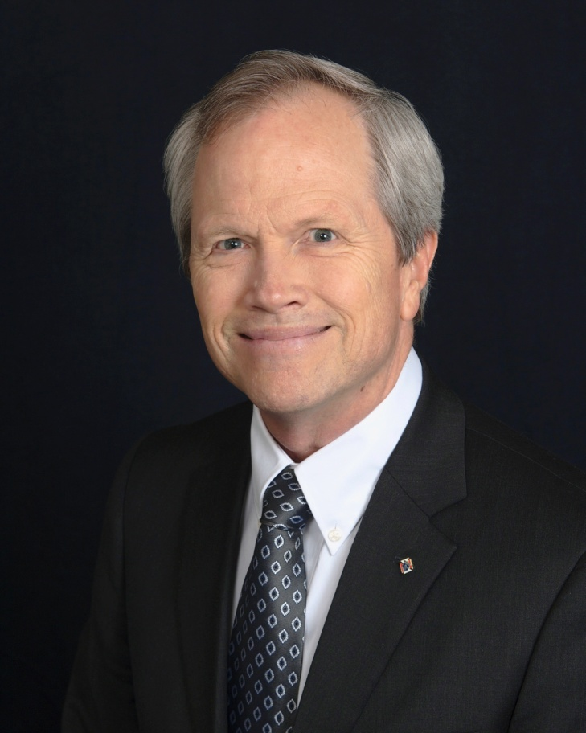
Council Communication and Public Relations (PR)
Andy Airriess
Knights of Columbus Immediate Past State Deputy

Slide 56
Public Relations

Slide 57
Public Relations

Slide 58
Communication

Slide 59
Communication
3 Kinds of Communication
Council to Members
Council to Parish
Council to Community

Slide 60
Council to Members Communication
Why?
Participation
Charitable contributions
Recognition
Retention
Emails, Facebook, Instagram, newsletters, web site

Slide 61
Council to Parish Communication
Why?
Charitable contributions
Recognition (Knight/Family of Month)
Membership
Retention
Pulpit announcements, posters, bulletin entries, web site, Facebook/Instagram.

Slide 62
Council to Community Communication
Why?
Charitable contributions/participation
Recognition
Community Newspapers, Intermountain Catholic

Slide 63
Who Should Do This?
Chancellor?
Comes to meetings
Comfortable with Technology
Works with Program Chair

Slide 64
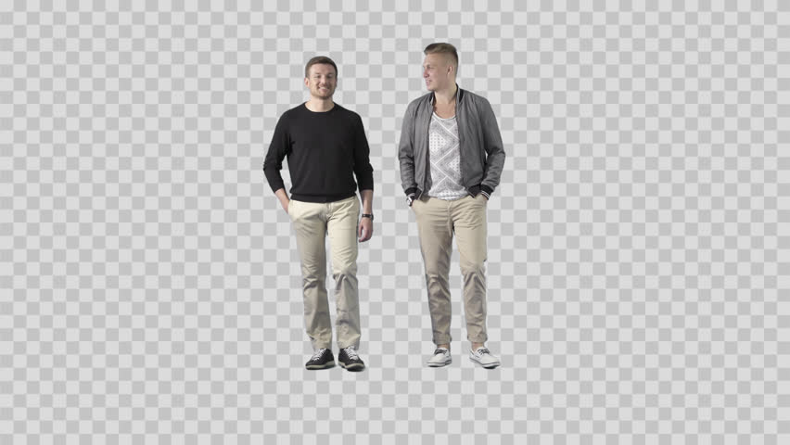
Pictures

Slide 65
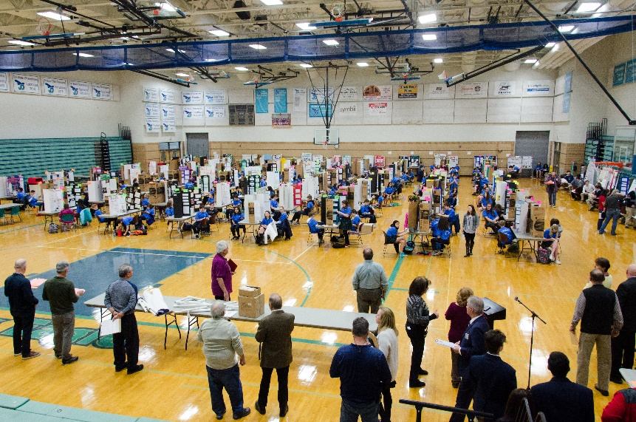
Pictures

Slide 66
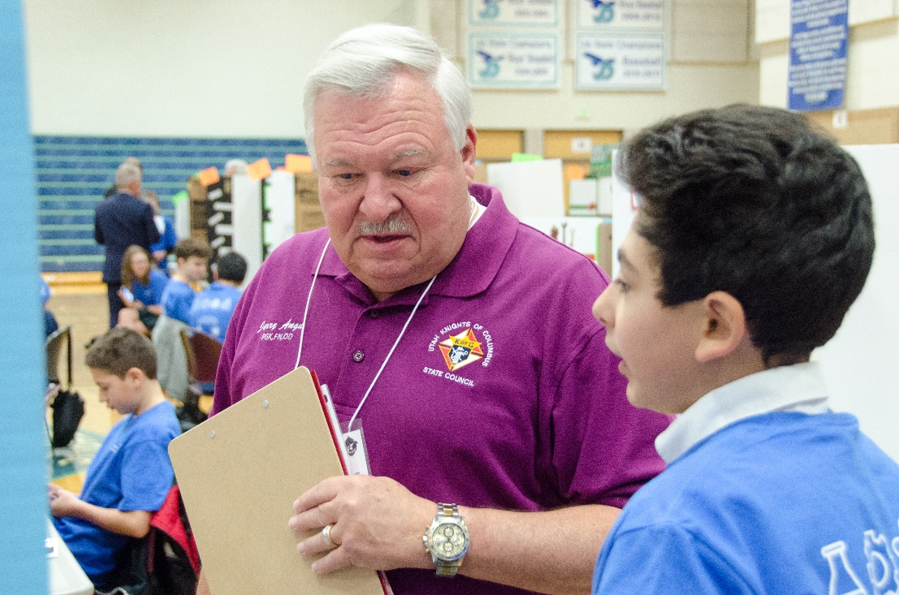
Pictures

Slide 67
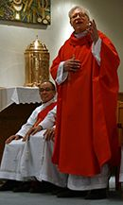
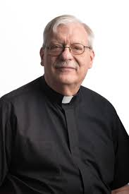
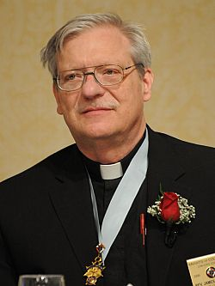
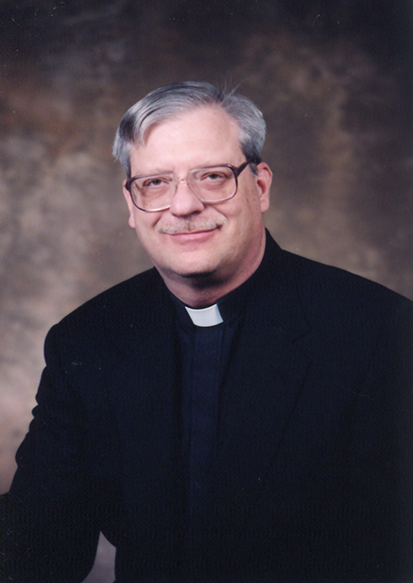
Pictures
Include Your Priest

Slide 68
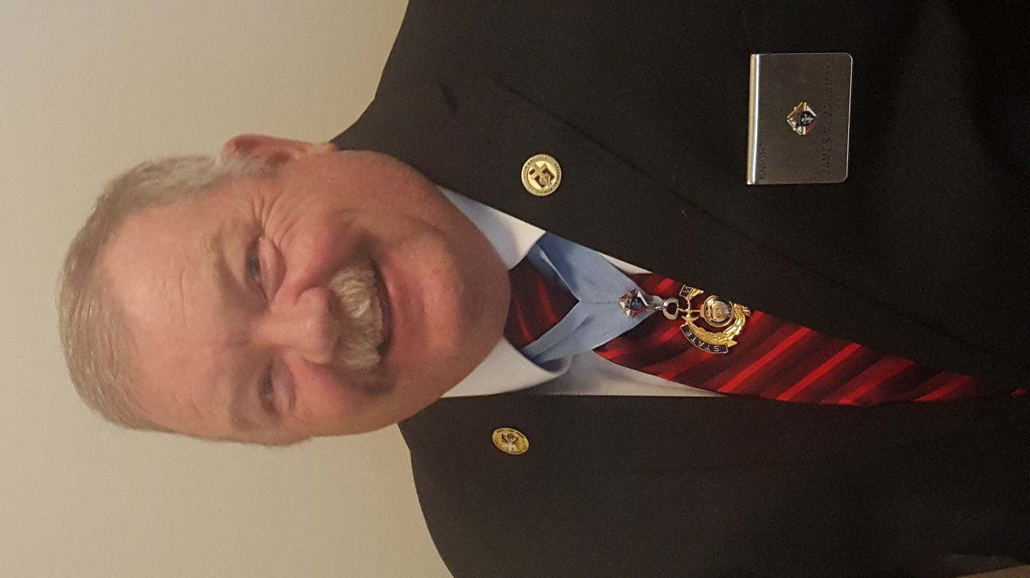
Council Budget
James McManaman Knights of Columbus Utah State Treasurer

Slide 69
Budget for upcoming year
Hold an officer meeting to discuss things your council wants to do.
Start with reoccurring items
Coats for Kids
Per Capita (State and Supreme) NOT OPTIONAL
Special Olympics
Christopher Fund
Bishop’s Vocation Fund
Scholarship Endowment Find
Bishop’s Culture of Life Fund

Slide 70
Budget for upcoming year
Plan Fund Raisers
Fish Fry
Golf Tournament
Bingo
Council Dinners
Vote on these items one time. This saves having discussions throughout the year for items already approved. This will make your Council meeting run smoother.

Slide 71
Approved Items
Now the items have been approved by the council. Put dates on these items and the treasurer can send donations when the time nears thus eliminating donations being missed or late.

Slide 72
Where do we stand
Throughout the year you can review the budget during your meeting to determine if additional fund raises are needed or if you have additional money that needs to go to another cause.
Makes Auditing simpler

Slide 73
Updating easier
In future years you can compare expenses to budgeted item. This will make the new budgets easier and saves time.
It will be simpler in future years to ratify the budget because all you will need to do are minor adjustments.

Slide 74
Questions?

Slide 75
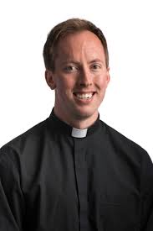
Vocation Support for Seminarians
Rev. Joseph Delka
Diocese of Salt Lake City Vocations Director

Slide 76
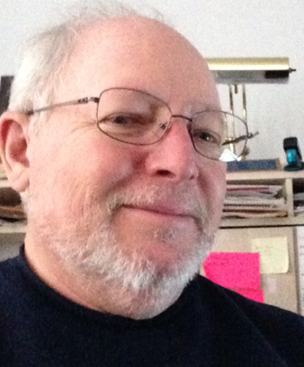
John Valdez State Faith Director State Vocations Chairman
Seminarian Support

Slide 77
Membership
James McManaman Knights of Columbus Utah State Treasurer Membership Director

Slide 78
Membership

Slide 79
Membership
Benefits of Membership
More members means more resources to support your parish and our Faith
Stronger Council
Building the Order
Bringing in new members let’s others see the good the Knights are able to do. It makes them want to be part of the GOOD
Helps members earn Shining Armor Award
Helps your Council achieve Star Council

Slide 80
Requirements for Star Council Award

Slide 81
Father McGivney Award
Recognizing excellence in membership growth, to win this award your council must meet or exceed its yearly membership quota.
Quota is 7% increase of council’s membership as of July 1 (minimum of 4 maximum of 35)

Slide 82
Columbian Award
Recognizing excellence in programming and charitable outreach, to win this award your council must conduct and report programs in each of the service categories
Submit SP-7 (due June 30)

Slide 83
Founders’ Award
Recognizing excellence in promotion of our top-rated and exclusive insurance products, to win this award your council must meet or exceed its yearly insurance quota.
Quota is 2.5% net increase in insurance membership s of July 1 (minimum 3 and maximum 18)

Slide 84
Fraternal Forms
Service Program Personnel Report (#365) due 8/1
Annual Survey of Fraternal Activity (#1728) due 1/31

Slide 85
In Good Standing Status
Current with Supreme assessments
Fully Compliant with applicable Safe Environment requirements

Slide 86
Membership
Membership Engagement
Getting new members involved allows seasoned members to pass on their knowledge and allow for new ideas to come out
Getting members involved makes them feel part of your council and help with retention
Makes communication flow better and everyone knows what is going on
Lets others see the benefits the Knights provide for the parish and community

Slide 87
Every Program an Opportunity
Every program in an opportunity for others to see what the Knights do and make them want to be part of our Order.
You have a captive audience that is interested in something the Knights are involved it. Don’t be afraid to ask someone to join
Knights involved show others the fun we have and the benefit we provide for the parish and they will want to be part of that
Wear our emblems proudly to show who we are

Slide 88
Where do you find new members
Look for good men in all Parish activities
RCIA Class
Lectors
Eucharistic Ministers
Scout Leaders
Teachers
Volunteers at Parish functions (Festivals, DDD Drives etc.)
Parents of First Communion and Confirmation student (They already see the benefits of being Catholic and pass that down to their children

Slide 89
Church Drives
Find a time that works for the Parish
Order supplies and materials
Bring in guest speakers to talk to people
Pick an activity that interests possible candidates
Follow up with potential Knights
Get the wives involved

Slide 90
These guys are willing to help

Slide 91
Anywhere and Everywhere
Anywhere they see Knights involved with an activity they are involved in already establishes the fact you have something in common with them and their values

Slide 92
Schedule and Run Degrees
Have your DD put it on the state calendar!
Be specific with location, registration time, POC E-mail and/or phone, other relevant info such as dress or how to get to room location (basement, etc.).
Details: Live vs. DVD. English/Spanish. Honoree.
Look at the state website to ensure your degree is listed and the information is correct.

Slide 93
Shining Armor Award
Attend Three Council Meetings
Meet with Benefits Advisor
Three Council Programs
Formation and Knighthood Degrees
Bring in Two New Members

Slide 94
Online Membership
Nick Nielson Knights of Columbus Utah State Secretary
Online Membership Chairman

Slide 95
Online Membership
Goals/Stats
15% of Total State Intake: 36 Online Members
That’s 3 new Online Member per month
Last Fraternal Year
30 Joined, 25 interested in transferring
16 transferred, 64% transfer rate

Slide 96
Online Membership
Who used Online Membership?
602, 1129, 1136, 5214, 5502, 6010, 7961, 9731, 12181, 12959, 14399, 14764, 15418
Most of these were initiated by the member – Council 7961 using to assist in achieving growth (they reached Double Star and dropped members!)
Councils with Online Member waiting to transfer: 5214, 5502, 6010 7961, 12959, 14764, 15418

Slide 97
Online Membership
Online Members contact info
Where do I look for Online Members?
How do I find their contact info?
How do I transfer them?

Slide 98
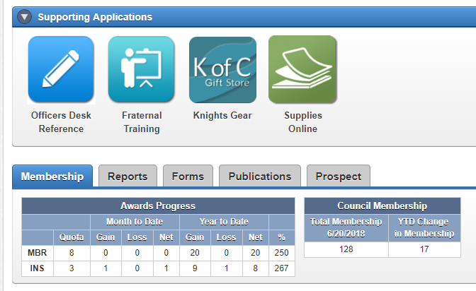
Online Membership
Online Members contact

Slide 99
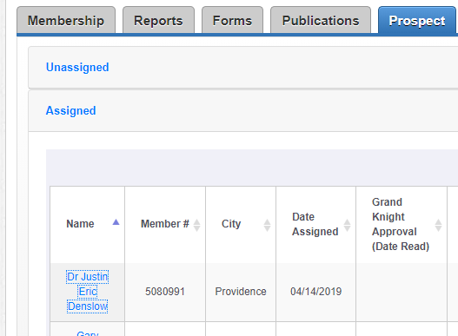
Online Membership
Online Members contact

Slide 100
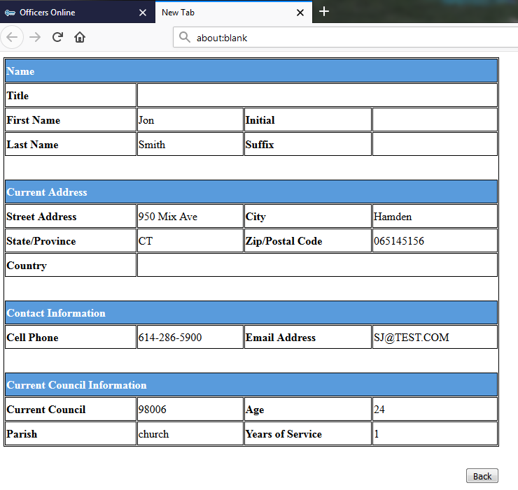
Online Membership
Online Members contact
Name
Address
Phone & Email
Parish info

Slide 101
Online Membership
Online Members contact
Contact the online member – they already expressed interest in transferring
May take several attempts – person signed up online… What’s the best way to contact?
Right Answer: No best way… Some prefer email, some a personal phone call
Don’t give up, keep in contact and invite to events to help serve… show the value in transferring

Slide 102
Online Membership
Transferring Online Members
Only AFTER the member goes through the admission process and takes the degree should you transfer
Add the date they attended the Admission Degree Ceremonial
Hit update
Just that simple. It’s fast and effective

Slide 103
Online Membership
What are the Benefits of Online Membership?
What can you do?
What are you going to do?

Slide 104
Online Membership
Prospect Landing Pages
Who has one?
What are they?
A personal way to gather contact info
URL (Web address) contact info form
Use in conjunction with Church Drives, events or personal recruiting
Bookmark on your smart phone (must share with members)

Slide 105
Online Membership
Prospect Landing Pages
What they are NOT
Not a stand alone website
Used in conjunction with personal contact and recruiting
Don’t just link to your Council’s website
How do you get one?
http://info.kofc.org/pagerequest

Slide 106
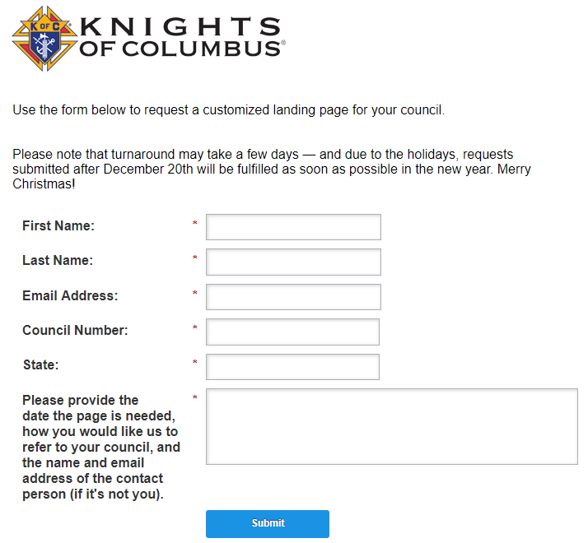
Online Membership

Slide 107
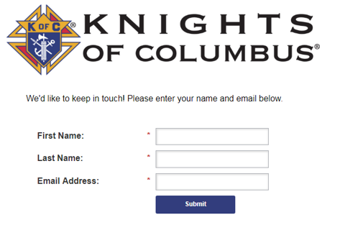
Online Membership
Prospect Landing Page
The Custom page simply asks for a prospects name and email (or custom info)

Slide 108
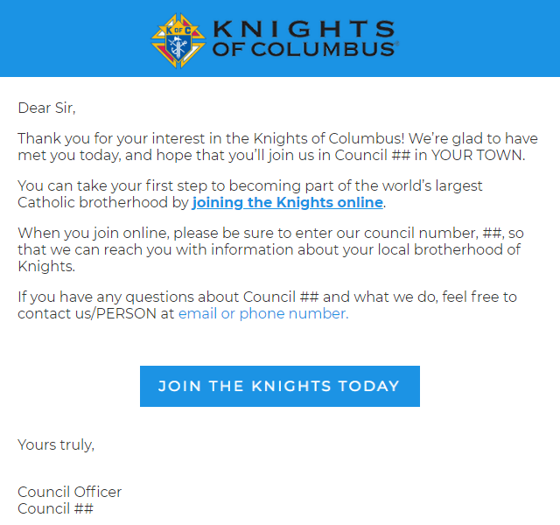
Online Membership
Prospect Landing Page
Prospect receives email
Council receives contact info to follow up

Slide 109
Online Membership
Questions?
Nick Nielson State Secretary Online Membership Chairman 801-618-6595 StateSecretary@utahknights.org

Slide 110
Break
Scheduled Break
2:50 PM to 3:05 PM
Financial Secretaries return from their break-out session.
Actual Break
Now until…
Have dinner reservations tonight?
State Warden Ryan has the meal tickets.

Slide 111
The Lord’s Knights Car Club
Francisco Carmona Knights of Columbus District Master - Utah

Slide 112
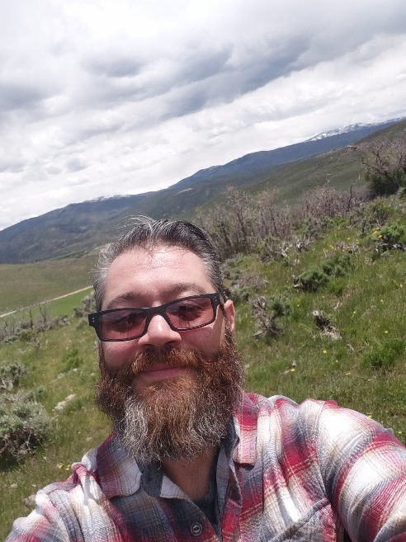
The Lord’s Knights Car Club
Anthony Moore Club President Knights of Columbus Grand Knight Council 9731
Francisco Carmona Knights of Columbus District Master - Utah

Slide 113
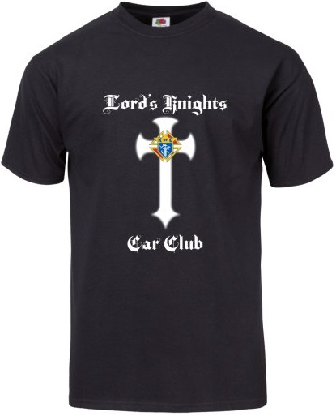
LKCARCLUB.ORG
Lord’s Knights Car Club

Slide 114
LKCARCLUB.ORG “In God We Trust and Ride” “In Service to One, In Service to All” “Charity, Unity, Fraternity & Patriotism”
Who qualifies?
Must be a member of the Knights of Columbus
18 years or older, male, and practical Catholic
Must be in good standings with the Council and or Assembly
Have current membership/travel card
Must own a classic car (30 years or older) within 6 months of application
Must have a high line car (expensive) within 6 months of application
Open to all councils around the world
GK. Anthony Moore
Club Pres.
Tel: 801-509-3239
amoore@espplus.net

Slide 115
Closing Remarks
Andy Airriess
Knights of Columbus Immediate Past State Deputy

Slide 116
Closing Remarks
Ken White
Knights of Columbus
Regional Training Director

Slide 117
Closing Remarks
Greg Keller Knights of Columbus Utah State Deputy

Slide 118
Closing Prayer
William “Bill” Kelly Knights of Columbus Utah State Advocate

Slide 119
Utah State Council Organization Meeting Adjourned! Mass is at 5:30 PM (Church) Honor Guard assemble at 4:30 PM 6:30 PM Social, 7:00 PM Dinner

